Slide 1
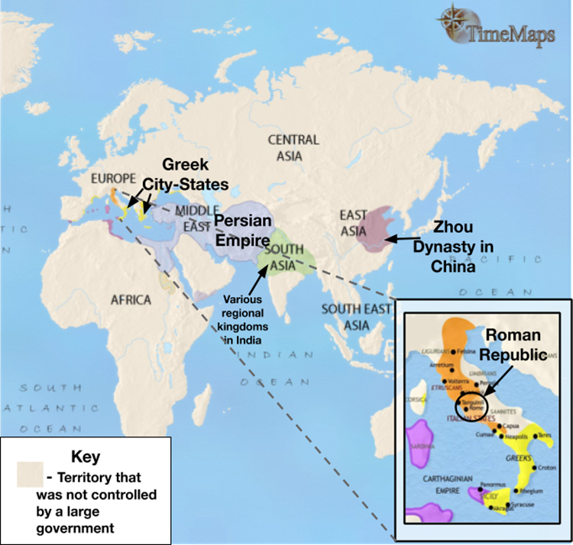
Aim: What was the geographic context for the rise of classical civilizations in Greece?
Do Now: What do the words “Classic” and “Classical” make you think of?
“Classical Age”
“The Classical Era”
“The Classical Period”
“The Age of Classical Civilizations”

Slide 2
What and when was the Classical Era? What makes a civilization "classical?"

Slide 3
Classical Era/Period/Age (600 BCE- 900 CE)
Period of time in which complex civilizations expanded to establish large land empires and were more interconnected through trade than earlier civilizations. These civilizations made great contributions to our collective learning as a result of golden ages marked by prosperity. Much of the culture and major belief systems that still impact our world were established during this time.
Based on the definition above, why do you think we study the Classical Era?

Slide 4
What is Periodization?

Slide 5
Periodization
the process or study of dividing the past into periods of time and naming them

Slide 7
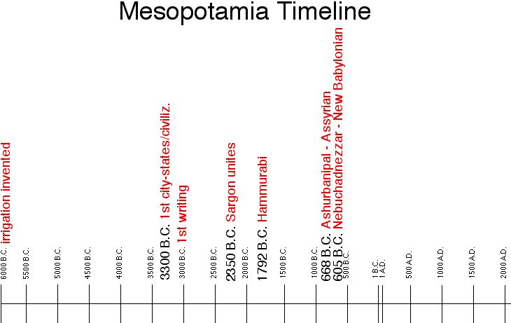

Slide 8
Map 1: Classical Civilizations in 500 BCE

Slide 9
Map #2: Classical Civilizations in 200 BCE

Slide 10
Map #3: Classical Civilizations in 200 CE

Slide 11
Trade in the Classical World

Slide 12
Mediterranean Sea Complex

Slide 13
Greece-Physical Geography
Balkan Peninsula (Peloponnesian Peninsula)
Surrounded by seas
Mediterranean Sea
Adriatic Sea on West, Aegean Sea on East
Made trade/travel easier
Lack of natural resources
Cultural Diffusion
Colonies
Mountainous
80% of Greece covered by mountains – difficult to cross
Lack of farmland
Protection from invasions
Lack of unity – development of city states

Slide 14
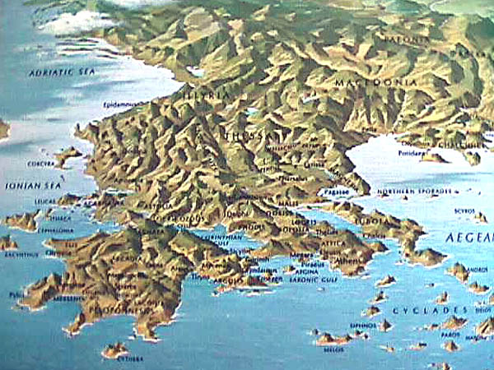

Slide 15
Ancient Greek Culture
Cut off by mountains and the seas
Isolated
Led to the formation of city-states (polis) which were separated from each other
Limited interaction and unity of Ancient Greece
Created fierce rivalries
Sea became a vital link
Hundreds of bays to provide safe harbor for ships
Skilled sailors
Traded olive oil, wine, and marble
Returned with grains, metals, and ideas
Adapted the Phoenician alphabet
Became basis for all Western alphabets

Slide 16
I. Mountains and Seas
Negative Effects
Positive Effects
Transportation difficult
Non-navigable rivers = lack of trade
Lack of political unification
Lack of natural resources
Lack of arable land/food
ONLY 3 principle crops
Olives, grapes, grains
Long coast line = ports, food, trade
Protection
Link to other societies/cultural diffusion

Slide 17
Climate of Ancient Greece
Greece has a Mediterranean climate
Winters are mild and wet
allows for limited farming
grapes and olives
Summers are warm and dry
leads to drought
grapes and olives are one of the few plants that can survive the summer droughts

Slide 18
City - States
Small cities and surrounding lands.
Separately governed
geography video clip

