Slide 1
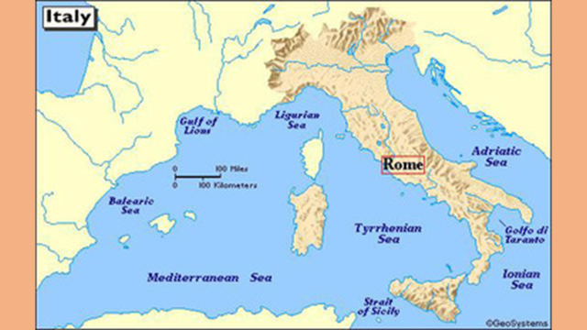
Aim:What was the geographic and historical context for the rise of classical civilizations in Rome?

Slide 2
The Roman Empire began in the year 330 BC and died out in 1453 AD. Its start was only 7 years before the fall and death of Alexander the Great.

Slide 3
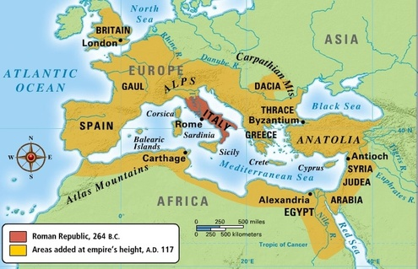

Slide 4
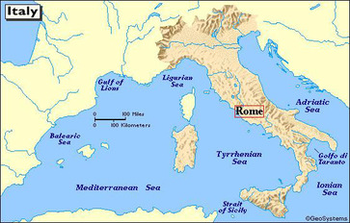
Geography of Italy
Mountains
Alps- protection from invasion
Protection from harsh climate
Apennine divided east & west Italy
protection from invasion
Italian Peninsula
Surrounded by 3 bodies of water:
Adriatic, Ionian, Tyrrhenian
Reaches out into the Mediterranean
Encouraged trade
Helped create an empire
Encouraged cultural diffusion
Location
Easy access to Africa, Greece, Spain, Gaul
Rivers
Rome is situated on the Tiber River

Slide 5
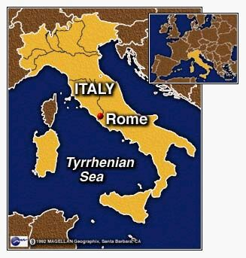
Geography
Location of Rome
Italian Peninsula (Italy today)

Slide 7
https://online.seterra.com/pdf/europe-countries.pdf
https://online.seterra.com/en/pdf/4007

