Slide 1
Aim: Why did World War I break out?
Homework #3: Due Thursday
Read 713-717
Page 717 –
Questions 2,4 & 7
Do Now:
What is an alliance?
Is it a good thing for nations to form alliances?

Slide 2
Alliance: an agreement between countries to help each other. Formed to advance common interests or causes
Pros (argument for)
Cons (argument against)
Can discourage an enemy attack
Can help protect you from an enemy attack
Could get new enemies
Allies can draw you into a war
A nation might act more aggressive

Slide 3
What alliances formed before World War I?

Slide 4
What alliances formed before World War I?
Triple Alliance
Triple Entente
Germany
Austria-Hungary
Italy
France
Russia
Great Britain

Slide 5
Did splitting up into alliances make war more or less likely?

Slide 6
What other factors encouraged war in 1914?

Slide 7
Underlying Causes of World War I
Militarism - glorification of war
- arms race
Alliances -more willing to risk war
Nationalism - wanted to prove superiority –ethnic groups demanding independent nations
Imperialism - disputes over colonies
Assassination - Immediate Cause “SPARK” –assassination of Archduke Franz Ferdinand of Austria-Hungary by Gavrilo Princip a Serbian Nationalist

Slide 8
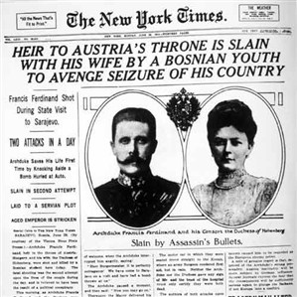

Slide 10
World War I
Central Powers
Allied Powers
Germany
Austria
Ottoman Empire
Serbia
England
France
Russia
Italy
United States
Japan

Slide 11
Militarism Aggressive military preparation; exalting the military ideal: building a military culture
Imperialism One nation taking over a weaker nation to exercise control over it
Nationalism Devotion to the interests of one’s nation or having pride in one’s country

Slide 12
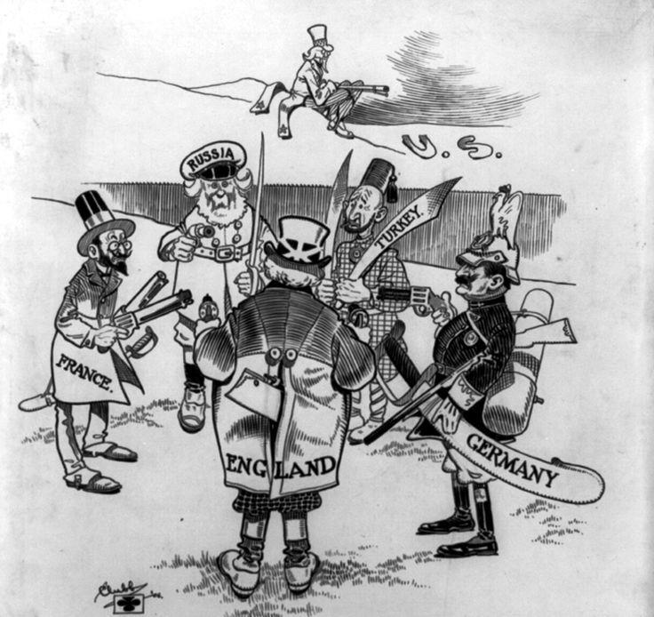

Slide 14
