Slide 1
Aim: How did World War II affect American living on the Home Front?

Slide 2
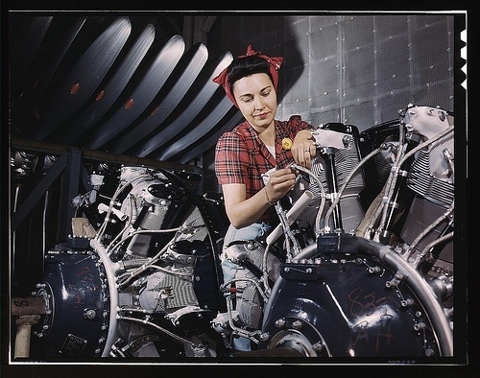

Slide 3
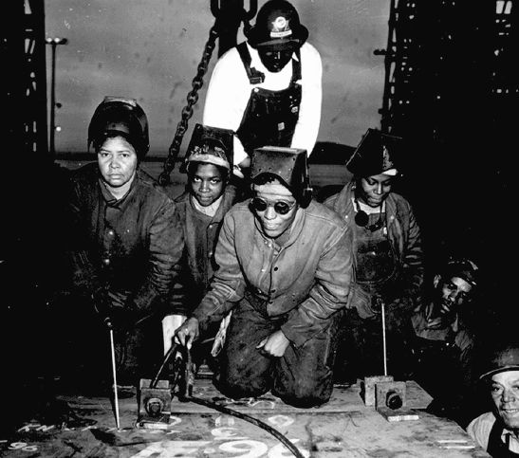
Impact of War on Women and African Americans
Women
moved into workforce in large numbers (“Rosie the Riveter”
African-Americans
Resumption of Great Migration
Executive order prohibiting discrimination by defense contractors
Military still segregated
Many questioned hypocrisy of fighting war against racism abroad while discrimination existed at home

Slide 4
Do Now:
What if there was a terrorist attack in the U.S. where the terrorists happened to be of your ethnicity and on basis of this attack and common ethnicity you and your family were sent off to live in a camp by order of the President?
What points would you bring up in order to not be forced to go?
How else do you think you might be able to get out of being relocated?

Slide 5
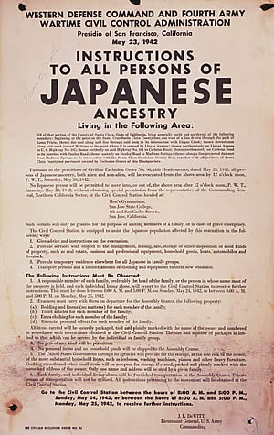

Slide 6
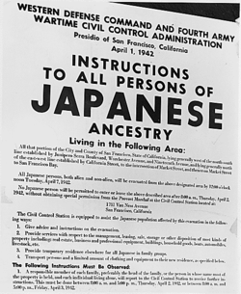
Executive Order 9066 (1942)
Korematsu v. United States (1944)
mass transportation and relocation of more than 120,000 Japanese-Americans to government detention camps
Issue – Did relocation of Japanese Americans violate their 5th Amendment due process rights?
Decision – No. Wartime need for national security supersedes 5th amendment protections.
Anything wrong with the decision?
1988 - President Ronald Reagan signed a bill- each surviving internee received $20,000 and an apology from the U.S. government.

Slide 7
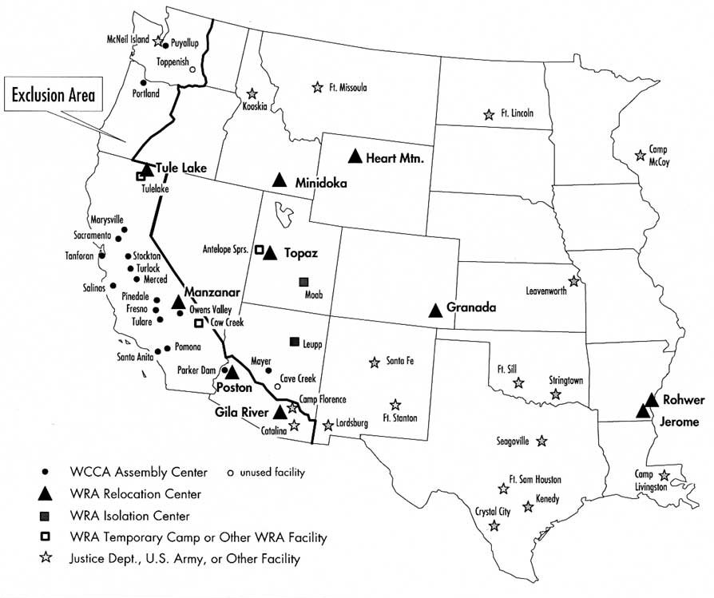

Slide 8
Camp | Dates in Operation | Peak Prisoner Population | Prisoner Population Origin (Where prisoners came from)
Granda | August 1942 - October 1945 | 7318 | Northern California coast, Sacramento, and Los Angeles
Gila River | July 1942 - November 1945 | 13,348 | Sacramento, Fresno County, Los Angeles area
Heart Mountain | August 1942 - November 1945 | 10,767 | Santa Clara County, Los Angeles, Central Washington state
Jerome | October 1942 - June 1944 | 8497 | Central California
Manzanar | March 1942 - November 1945 | 10,046 | Los Angeles, Central California, Bainbridge Island (Washington)
Mindoka | August 1942 - October 1945 | 9397 | Seattle, Portland, Northwest Oregon
Poston | May 1942 - November 1945 | 17, 814 | Southern California, Central California, Arizona
Rohwer | September 1942 - November 1945 | 8475 | Los Angeles and Stockton, CA
Topaz | September 1942 - October 1945 | 8130 | San Francisco
Tule Lake | May 1942 - March 1946 | 18, 789 | Sacramento area, Southwestern Oregon, Western Washington, Hawaii

Slide 9
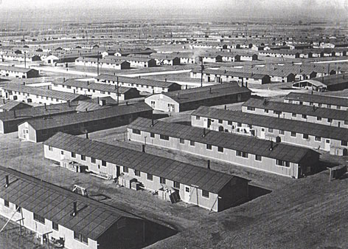

Slide 10
DAYS OF WAITING
1. What forms of discrimination did Japanese Americans face in California face prior to the outbreak of WWII? What examples of discrimination did the Ishigos face before the war and immediately after the Japanese attack on Pearl Harbor?
2. Explain the Ishigos journey during their time of relocation and immediately afterwards. Where were they brought at first? Where did they spend most of their time? Where did they go after the war ended?
3. How did interned Japanese-Americans attempt to establish normalcy during their time in the camps?
4. Explain the struggles the Ishigos faced following the war.

Slide 11
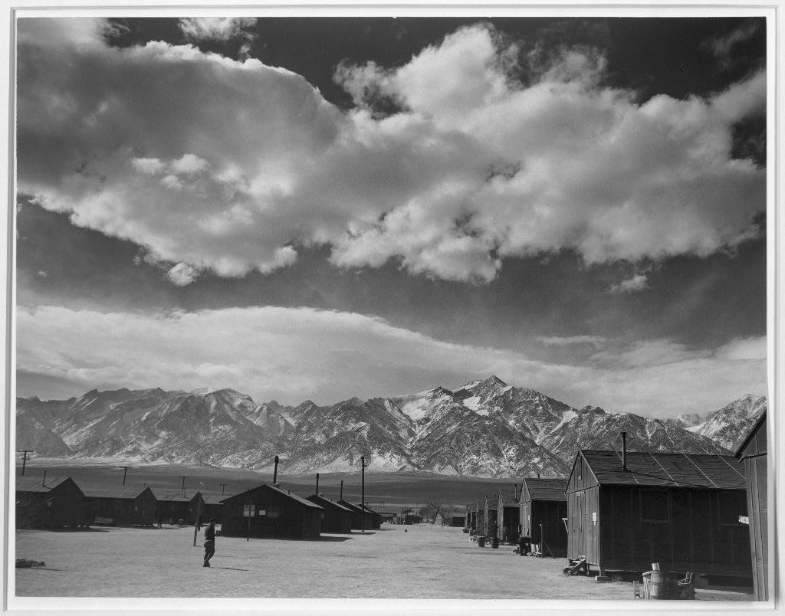

Slide 12
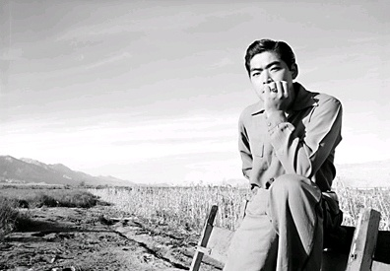

Slide 13
YouTube - Japanese American Internment (U.S. Govt Propaganda)
What labels, terms, are used to describe Japanese-Americans?
How does the film attempt to address the contradiction between the forced relocation and American Values and Ideals

